Slide 1
JavaScript and DOM Andrew Cumming
Creating Content…

Slide 2
Lecture Plan
Don’t run the JavaScript too soon, defer
Creating Content
Changing Elements
Applying CSS
Applying functions
Arrays and Objects in JavaScript

Slide 3
JavaScript
JavaScript runs in the browser
The DOM tree is representation of the the web page
There are functions to create and manipulate the DOM and so the page

Slide 4
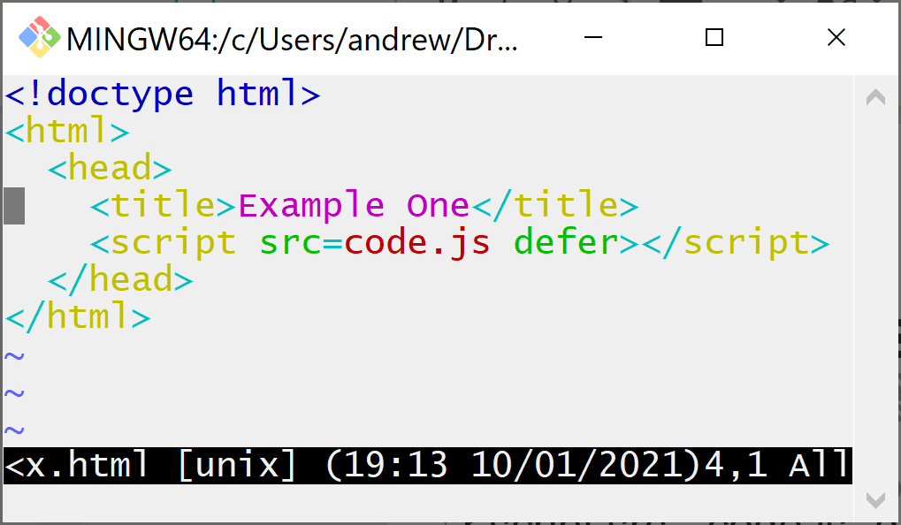
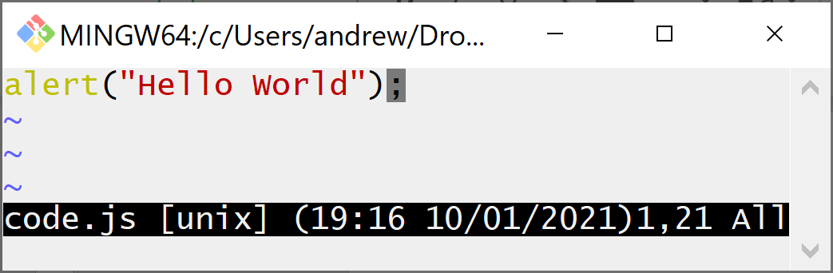
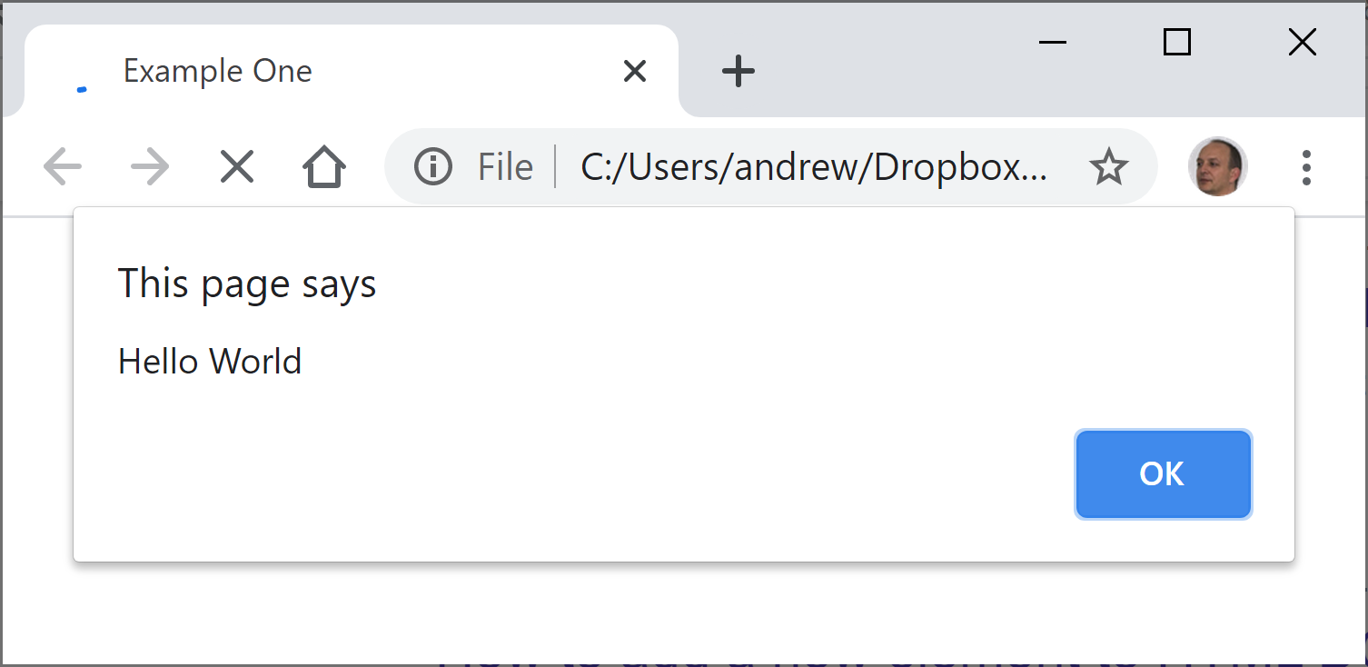
Preliminaries
<script src=“code.js“ defer></script>
The defer reference ensures that the code does not run until the page has loaded.
alert("Hello World");
The alert function shows a modal prompt:

Slide 5
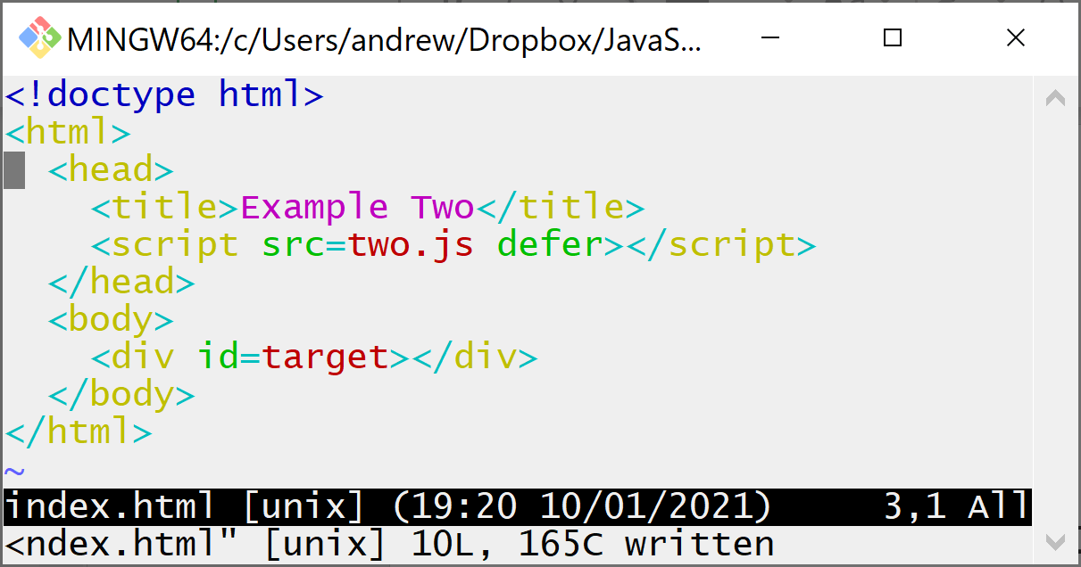
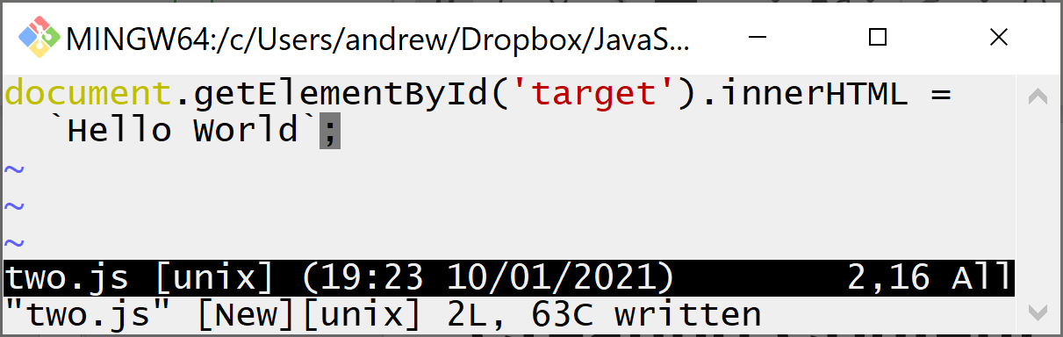
Creating Content
You can create content using the innerHTML property.
You can find an element with getElementById.

Slide 6
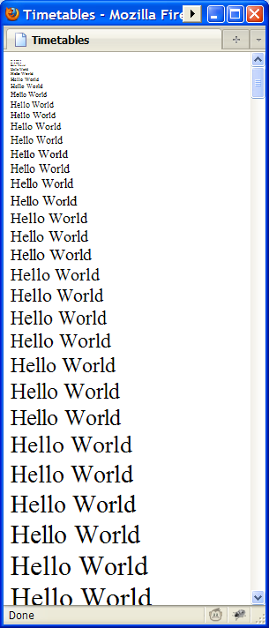
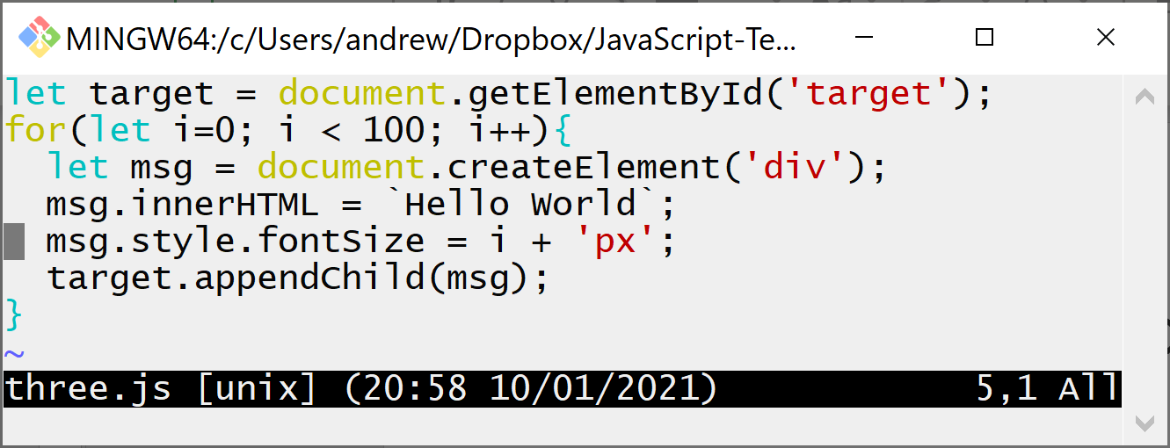
Creating Content and Changing it
After you create a node you can change it:

Slide 7
Some useful DOM functions
document.getElementById
Ready function, create elements, find elements
elem.appendChild
The append function adds to the end of an element
elem.innerHTML = …
Set the content
elem.style.fontSize = …
The function css is used to set a css property of an element
elem.textContent = …
Change the text in a safer way

Slide 8
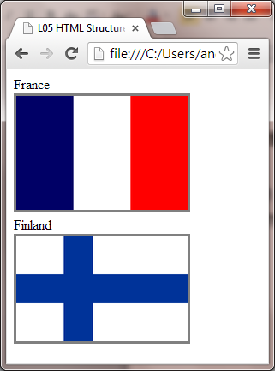
Creating structures
You often need to create elements that contain other elements.
<div id='countries'>
<div id='fr'>
<div>France</div>
<img src='flags/fr.gif'/>
</div>
<div id='fi'>
<div>Finland</div>
<img src='flags/fi.gif'/>
</div>
</div>

Slide 9
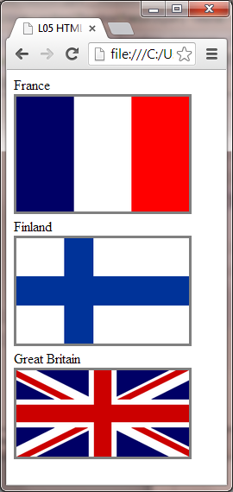
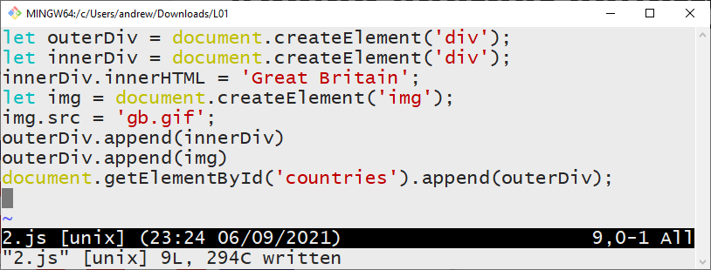
Adding another country

Slide 10
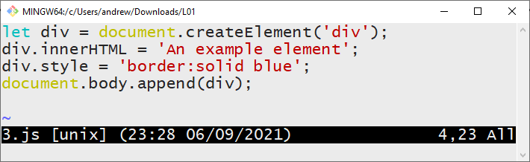
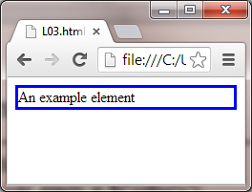
Examples of use

Slide 11
Self Test
Select the correct script element
<script href=x.js pause></script>
<script hreg=x.js refrain></script>
<script scr=x.js defame></script>
<script src=x.js defer></script>
<script rcs=x.js retain></script>

Slide 12
Selecting one item
You can select items with the .getElementById method
The result is a single item.
This will remove the France div
let f = document.getElementById("fr").remove()

Slide 13
Select multiple items
You can use document.querySelectorAll to find a list of elements that match a pattern.

Slide 14
Select items with items
A common pattern is to select elements within a named element:
table#main td
Select all td elements within the table with id main
ul#nav li
Select all li elements inside the ul named nav

Slide 15
Combining terms
As with css you can combine terms.
When one term follows another separated by a space then the second is a descendant of the first
table tr td
div#content p
A > indicates a direct descendant, a child
ul.menu>li prevents nested li elements matching
A comma allows an independent rule - OR

Slide 16
More to learn
You can navigate through the list
You can animate items
You can show, hide and toggle
You can apply functions to all items in the list
You can store data against elements and retrieve it.
You can use ajax functions
You can create other effects using add-ons

Slide 17
Summary
Creating Content
Changing Elements
Applying CSS
Applying functions
Lists of useful JavaScript and functions
Arrays and Objects in JavaScript
Tutorial material at http://progzoo.net/

